Slide 1
American literature 2
Anglo-American Modernism

Slide 2
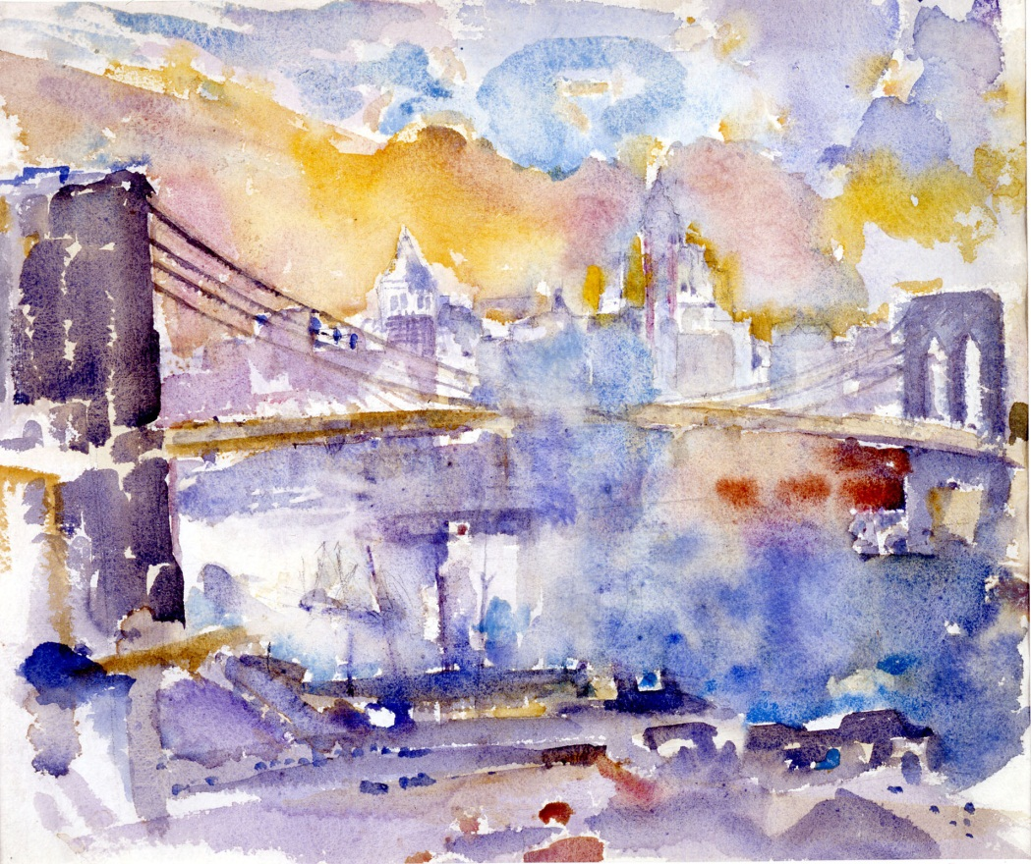
The second group of American modernist poetry was centered in Europe
inspired mainly by the European tradition
return to rhyme and regular form
John Marin: The Brooklyn bridge

Slide 3
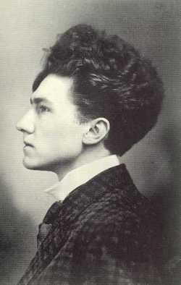
Ezra (Loomis) Pound
Poet, editor, translator
Imagism
Image is that which presents an intellectual and emotional
complex in an instant of time. Image is a picture of reality, nothing abstract.
The main principles of Imagism:
direct treatment of the poetic object
using no word that is not absolutely neccessary, or which does not contribute to the presentation
rhythm should be derived from music

Slide 4
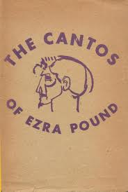
Pound was inspired by the European tradition because he wanted to find literary sources and methods which were forgotten or not explored to create a new type of modern poetry
inspired by the ancient Greek mythology, by Renaissance and Provencal poets.
The Cantos, which he wrote and published until his death. It is a poetic sequence that is supposed to contain the whole history of mankind, the history of culture and civilization.

Slide 5
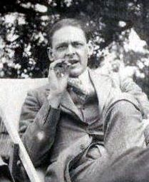
T.S. Eliot
Nobel Prize
Works: Prufrock and Other Observations,
The Waste Land, Ash Wednesday
Four Quartets ; Murder in the Cathedral, The Family Reunion
Wasteland:
Inspired by: Sir James Frazier's The Golden Bough
rediscovered the French symbolist poets (including Baudelaire and Laforgue) and the metaphysical poets (most notably John Donne

Slide 6
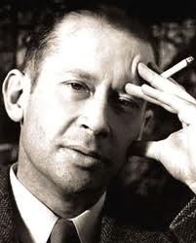
Edward Estlin Cummings (e.e. cummings)
experimented radically with form, punctuation, spelling and syntax, abandoning traditional techniques and structures
e.e. cummings - [l(a]
l(a
le
af
fa
ll
s)
one
l
iness

Slide 7
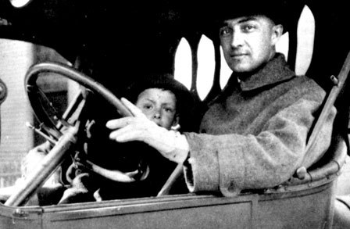
William Carlos Williams
principal poet of the Imagist movement
from Imagism to Objectivism: The main emphasis is put on objects not on ideas
Works: Kora in Hell, Spring and All, Paterson
This Is Just To Say
I have eaten
the plums
that were in
the icebox
and which
you were probably
saving
for breakfast
Forgive me
they were delicious
so sweet
and so cold

Slide 8
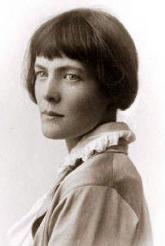
Hilda Doolittle (H.D.)
leader of the Imagist movement
Works: Trilogy, Helen in Egypt

