Slide 1
American literature 2
Drama between the wars

Slide 2
The beginnings of American drama:
For Puritans, drama was the work of devil
the 1767 Philadelphia production of Thomas Godfrey's The Prince of Parthia
I774 the Continental Congress banned plays
Most American plays were adaptations of European originals

Slide 3
American popular forms: vaudeville, burlesque, minstrelsy, the Broadway musical and Hollywood motion picture
William Dunlap:
founder of the national
theater.
free adaptations from French, German and Elizabethan sources.

Slide 4
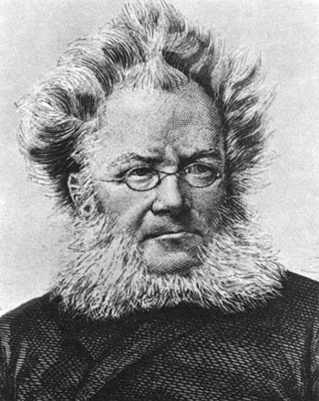
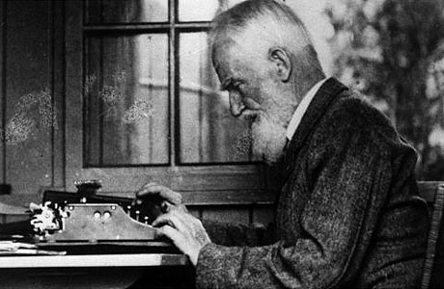
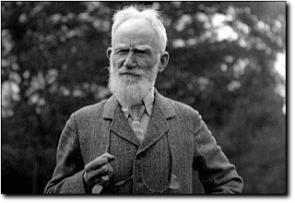
European influences:
William Shakespeare
Henrik Ibsen: father of realism;
Dolls’ House
G. B. Shaw: Pygmalion

Slide 5
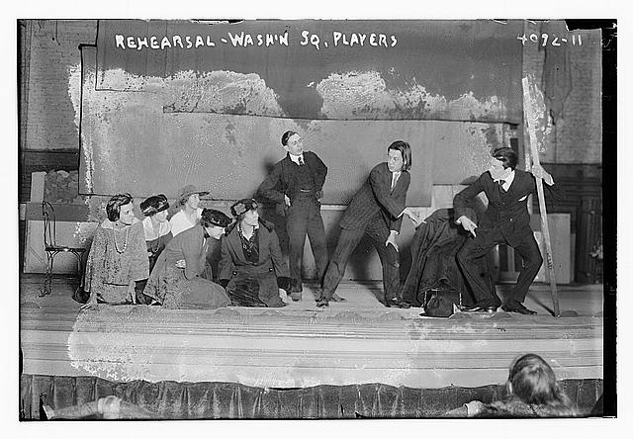
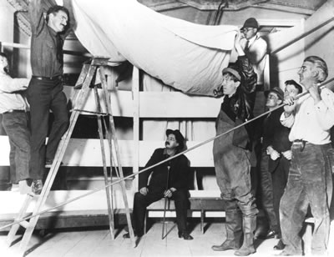
Theatrical companies after the WWI:
The Provincetown Players
Washington Square Players
Group Theatre
First to put on stage American playwrights

Slide 6
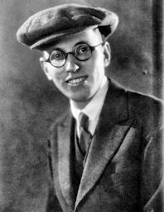
Elmer Rice (Elmer Leopold Reisenstein)
Works: On Trial, The Adding Machine, Street Scene
huge increase in production and regulation due to the new concept of the welfare state introduced in World War I
multinational corporations, towering factories and long assembly lines
On Trial: technique of the motion picture ‘cutback’ to present scenes and rotating stage

Slide 7
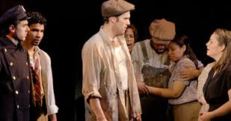
The Adding Machine: expressionist techniques of fantasy and symbolism to satirize the reduction of individuals, in the machine age, to ‘waste product
Street Scene: empirical realism in its presentation of slum life, sound effects, multiple action technique

Slide 8
The Provincetown Players
Among the founding members
of the group were
George Cram Cook, Susan Glaspell, Neith Boyce, Robert Edmond Jones, and, later, Floyd Dell.
In contrast to the Washington Square Players, the Provincetown
Players remained committed to experimental work

Slide 9
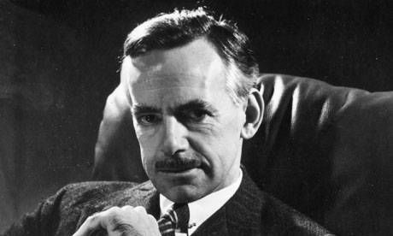
Eugene O'Neill
Nobel Prize in 1936 as the
only American playwright
Influenced by psychoanalysis
Greek choruses, single characters played by two actors,
cinematic flashbacks and elaborate stage masks
Works: Long Day's Journey into Night, Ah, Wilderness! , Dynamo,
The Hairy Ape, Desire Under the Elms

Slide 10
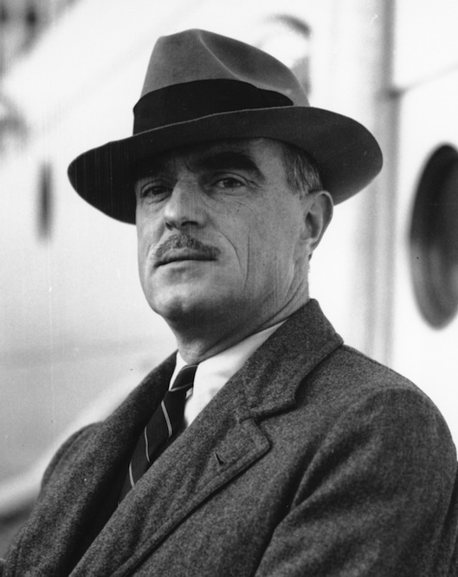
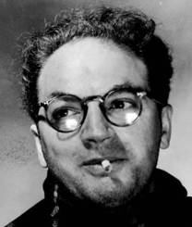
Thornton Wilder
Works: Our Town, The Skin of Our Teeth,
The Matchmaker (Hello Dolly)
Clifford Odets
Playwright of the Great Depression
Proletarian drama
Group Theatre
Works: Waiting for Lefty, Awake and Sing!, Till the Day I Die, Paradise Lost, Golden Boy

