Slide 1
American literature 2
Harlem Renaissance and
African American Literature

Slide 2
Booker T. Washington
Up from Slavery (1901)
Tuskegee Institute
Vs.
W. E. B. Du Bois
The Souls of Black Folk (1903)

Slide 3
Harlem Renaissance

Slide 4
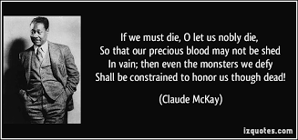
Langston Hughes
Jesse B. Simple

Slide 5
Countee Cullen
Jean Toomer
Cane (1923)

Slide 6
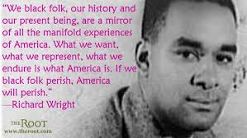
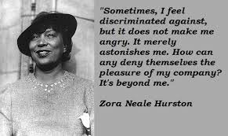
Richard Wright
Black Boy,
Native Son
Zora Neale Hurston
Their Eyes Were Watching God,
Mules and Men

Slide 7
Ralph Ellison
Invisible Man
James Baldwin
Everybody’s Protest Novel, Go, Tell it on the Mountain
Alice Walker
Color Purple
Toni Morrison
Song of Solomon, The Bluest Eye, Jazz

Slide 8
African American poetry
Major poets: Michael S. Harper and Rita Dove, Audre Lorde,
Yusef Komunyakaa, Gwendolyn Brooks, Maya Angelou
The Black Arts Movement
Amiri Baraka (born LeRoi Jones)
Poet and playwright
Works: Blues People: Negro Music in White America,
The Moderns: An Anthology of New Writing
in America, Preface to a Twenty-Volume
Suicide Note, Somebody Blew Up America

