Slide 1
American literature 2
American Postwar Poetry

Slide 2
Formalism
1940s and 1950s
Academic formalism influenced by New Criticism
(see lecture Southern literature)
Howard Nemerov, Richard Wilbur, Randall Jarrell

Slide 3
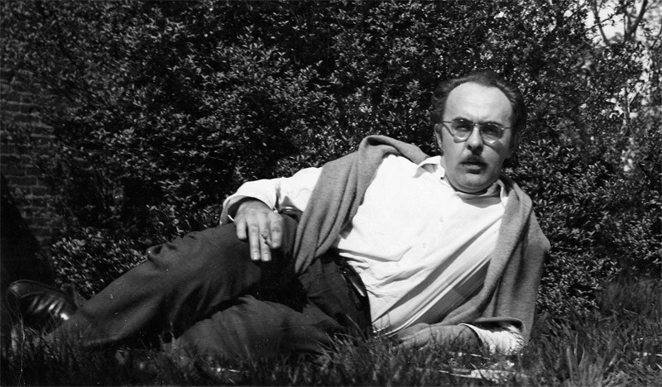
The Black Mountain School
Influenced by Pound, Eliot, W.C. Williams
Robert Duncan, Robert Creeley, Charles Olson
Charles Olson
projective verse
Works: Maximus and
Other Poems

Slide 4
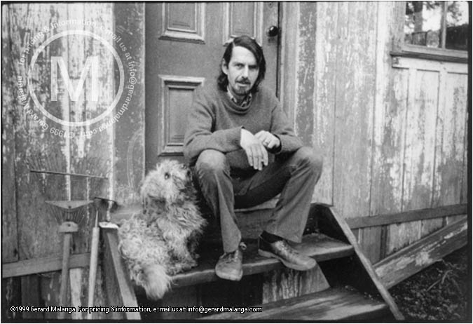
Robert Creeley
Inspired by jazz, Allen Ginzberg
lyrical minimalist
A Poem
If the water forms
the forms of the weeds, there—
a long life is not by that
a necessarily happy one.
My friend. We
reckon on a simple
agreement,
the fashion of a stone
underground.

Slide 5
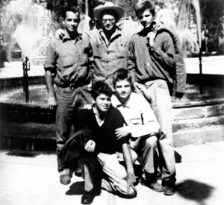
Predecessors of the Beat Generation
San Francisco Renaissance
influenced by Whitman,
off-mainstream poetry
Kenneth Rexroth, William Everson, Robin Blaser, and Michael McClure, Robert Duncan

Slide 6
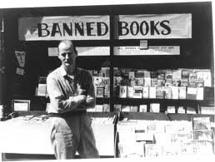
Lawrence Ferlinghetti
City Light Publishing: publishing writers such as
Kenneth Rexroth, Gary Snyder, Allen Ginsberg, and Jack Kerouac.
Works: Americus, Book I ., San Francisco Poems
translated the work of a number of poets including
Nicanor Parra, Jacques Prevert, and Pier Paolo Pasolini

Slide 7
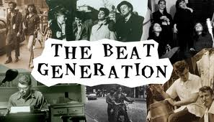
The Beat Generation
founded by Allen Ginsberg and Lucien Carr in 1944
Other members: Jack Kerouac, William Burroughs, John C. Holmes,
Carl Solomon, Gregory Corso
openness to varieties of experience, the cultural "underground"
of bebop jazz, drug use, "polymorphous perverse" sexuality,
and non-Western religions

Slide 8
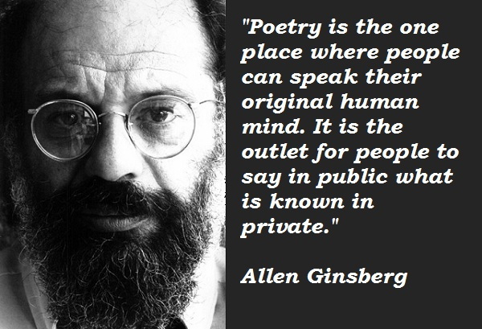
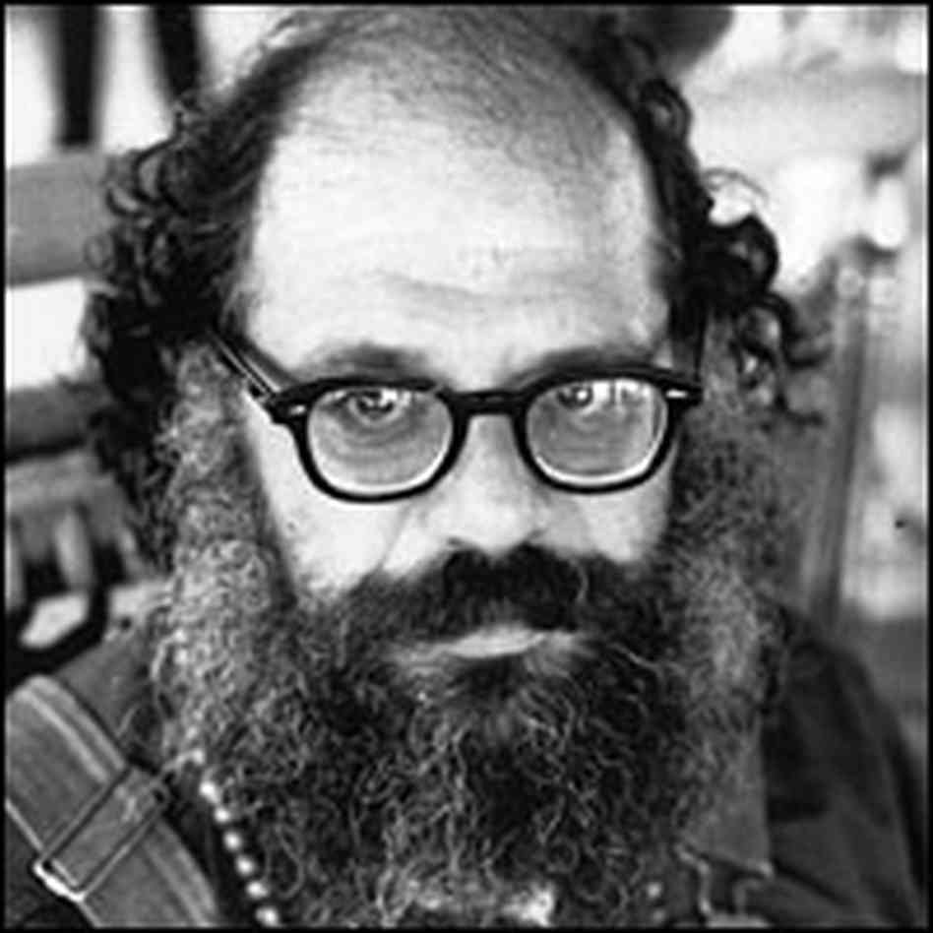
Allen Ginsberg
Influenced by Whitman, Blake
Works: 'Howl‚ „Kaddish“

Slide 9
Confessional Poetry
Narrative, no taboo subjects, unbalanced protagonists, irony,
free verse, mental disorders
Robert Lowell
studied poetry with Robert Penn
Warren and Cleanth Brooks
under John Crowe Ransom
Works: Land of Unlikeness,
Lord Weary's Castle , Life Studies

Slide 10
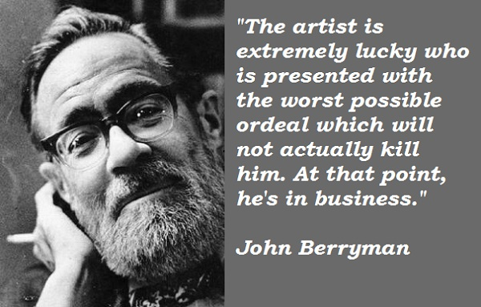
John Berryman
Works: Dream Songs

Slide 11
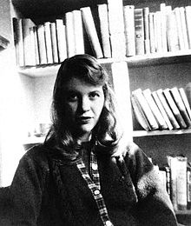
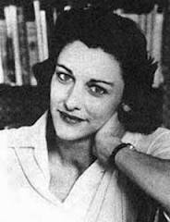
Sylvia Plath
Studied with Anne Sexton under Robert Lowell
Electra complex poetry
Works: Colossus, The Bell Jar, Ariel
Anne Sexton
Suffered from clinical depression, poetra as therapy
Live or Die, To Bedlam and Part Way Back

Slide 12
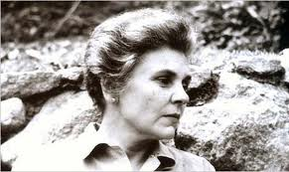
Female/Feminist Poets
Elizabeth Bishop
More conservative, critical of confessional poetry
One Art
by Elizabeth Bishop
The art of losing isn't hard to master;
so many things seem filled with the intent
to be lost that their loss is no disaster.
Lose something every day. Accept the fluster
of lost door keys, the hour badly spent.
The art of losing isn't hard to master.
Then practice losing farther, losing faster:
places, and names, and where it was you meant
to travel. None of these will bring disaster.

Slide 13
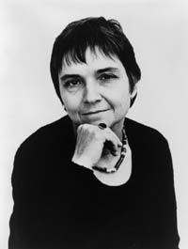
Adrienne Rich
Poet and critic
Works: Dream of a Common Language,
On Lies, Secrets, and Silence: Selected Prose, 1966-1978
Translations
December 25, 1972
You show me the poems of some woman
my age, or younger
translated from your language
Certain words occur: enemy, oven, sorrow
enough to let me know
she's a woman of my time
obsessed

Slide 14
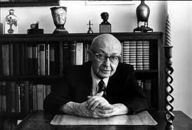
American Jewish Poetry
Themes: multiculturalism, the search for identity
and search for poetics
Charles Reznikoff
Found poetry
Works: Testimony, Holocaust

Slide 15
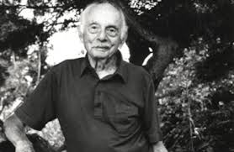
Stanley Kunitz
influenced by British Metaphysical poets, Blake and their modernist followers:
T.S. Eliot or Ezra Pound.
Works: Intellectual Things, Passport to War
Later more confessional: ‘The Layers
I have walked through many lives,
some of them my own,
and I am not who I was,
though some principle of being
abides, from which I struggle
not to stray.

Slide 16
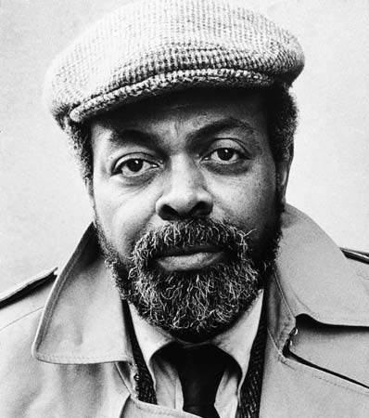
African American poetry
The Black Arts Movement
Amiri Baraka (born LeRoi Jones)
Poet and playwright
Works: Blues People: Negro Music in White America,
The Moderns: An Anthology of New Writing
in America, Preface to a Twenty-Volume
Suicide Note, Somebody Blew Up America
Major poets: Michael S. Harper and Rita Dove, Lucille Clifton, Audre Lorde,
Yusef Komunyakaa

