Slide 1
American literature 2
Postwar American Fiction

Slide 2
War Novelists
Joseph Heller (1923–1999) Catch 22,
Norman Mailer (1923) The Naked and the Dead,
Herman Wouk (1915), The Winds of War
Irwin Shaw (1913–1984) Young Lions
Leon Uris (1924–2003) Mila 15

Slide 3
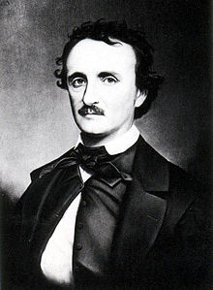
Kurt Vonnegut
Slaughterhouse-Five
The Sires of Titan
Cat’s Cradle

Slide 4
E. L. Doctorow
Historical fiction: re-creates the history of the land and the various races
Works: Welcome to Bad Times, The Book of Daniel, Ragtime

Slide 5
John Cheever
Suburban fiction
Vladimir Nabokov
Works: Lolita

Slide 6
J(erome) D(avid) Salinger
Works: Franny and Zooey (1961),
Raise High The Roof Beam, Carpenters (1963)
The Catcher In The Rye (1951)
Truman Capote
Works: Breakfast At Tiffany’s (1958)
In Cold Blood (1966)

Slide 7
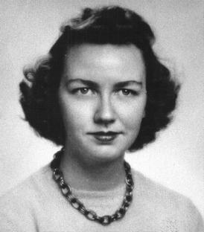
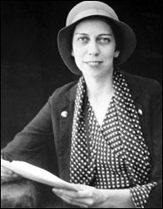
Flannery O'Connor
Usage of irony, Roman Catholic influence, portrayal of postwar South
Works: Wise Blood, Good Man is Hard to Find,
Everything that Rises Must Converge
Eudora Welty
Modernist techniques, influenced by old Greek mythology
Works: The Ponder Heart, Losing Battles, The Optimist’s
Daughter

Slide 8
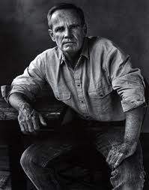
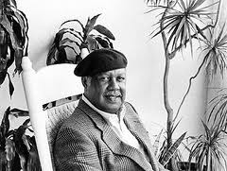
Western:
Cormac McCarthy
Southern Gothic, western, post-apocalyptic writing
Works: The Road, The Border trilogy: All the Pretty
Horses, The Crossing, The Cities of the Plain;
No Country for Old Men
African American Southern writer
Ernest Gaines
Regionalism, influenced by Faulkner
Works: Gathering of Old Men, Autobiography
of Jane Pitmann, Lesson Before Dying

Slide 9
Saul Bellow
Translated the most famous short story by I. B. Singer „Gimpel the Fool“
famous for his impersonal, intellectual style of his writing
influenced by Gustave Flaubert
Works: The Dangling Man, Dean’s December, Herzog, Mr. Sammler’s Planet
Bernard Malamud
Jewish-American identity, Jewish heritage, immigration and its effects
Magic realism
Works: The Assistant, The Natural , A New Life , The Fixer, The Tenants
Philip Roth
Postmodernist techniques
Works: Goodbye, Columbus, Patrimony, Dying Animal, Human Stain,
Operation Shylock

