Slide 1
American literature 2
Postwar drama

Slide 2
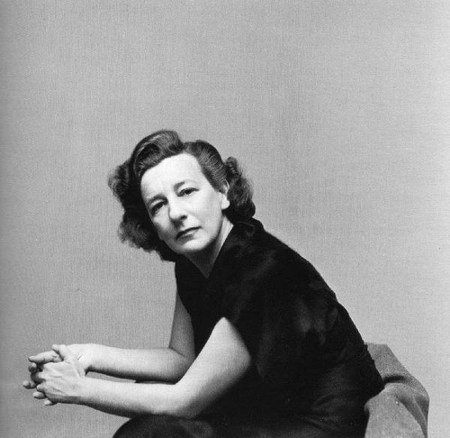
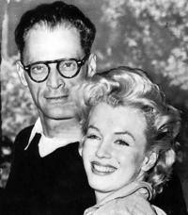
Lillian Hellmann
Jewish Southern dramatist
social changes of the American South, mainly
before and after the Civil war
Works: The Children’s Hour, Little Foxes, Another Part fof the Forest,
The Watch on Rhine
Arthur Miller
Social realism
Works: All my Sons, Death of a Salesman,
Crucible

Slide 3
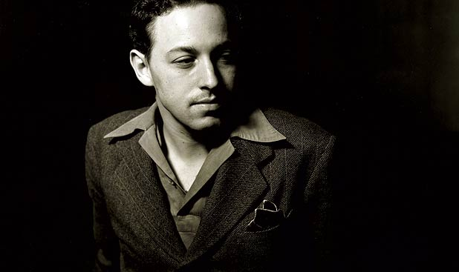
Tennessee Williams
sexual and psychological aspects of relationships,
which are traditionally controversial
main motifs: contrast and conflict between fragile, highly sensitive
character and the world or other characters that represent the animalistic,
aggressive forces

Slide 4
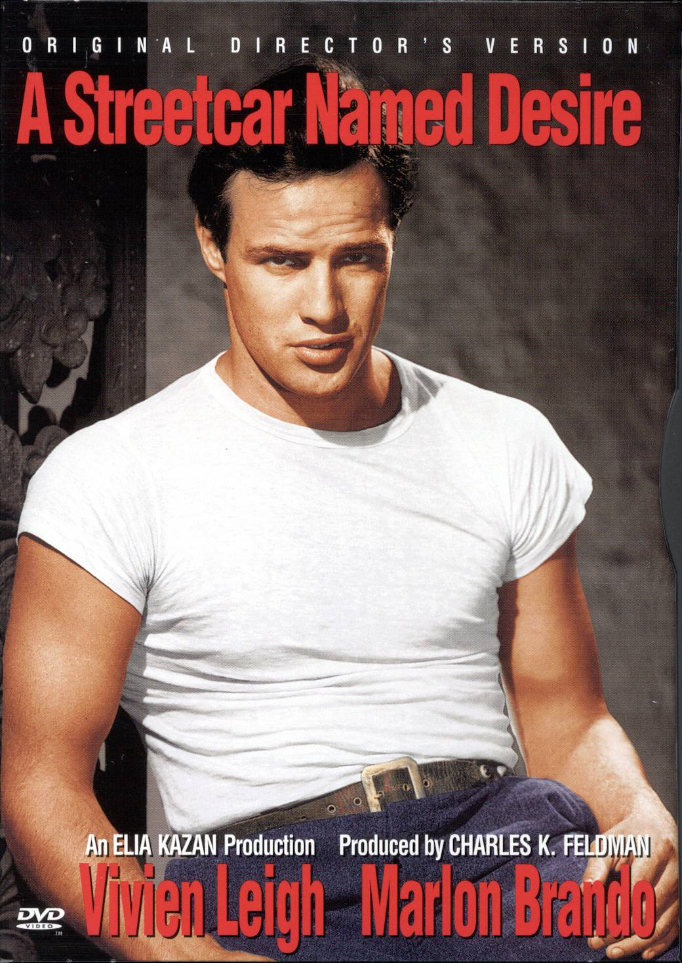
3 main groups of his plays:
1) early plays: Streetcar Named Desire (1947), Glass Menagerie (1945), Summer and Smoke (1948): most realistic works
2) surrealistic plays: The Rose Tatoo (1951),
Camino Real (1953)
3) critical plays: Cat on a Hot Tin Roof (1955),
Orpheus Descending (1957), Suddenly Last
Summer, (1958):
criticism of contemporary society

Slide 5
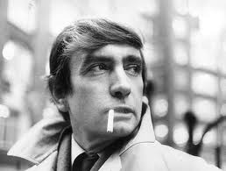
Edward Albee
Theatre of the Absurd.
a successor to American playwrights Arthur Miller,
Tennessee Williams, and Eugene O'Neill and European playwrights Samuel
Beckett and Harold Pinter
Works: The Zoo Story , Who's Afraid of Virginia Woolf?, The Death of Bessie
Smith, The Goat, or Who is Sylvia?
"Theater 1964"

Slide 6
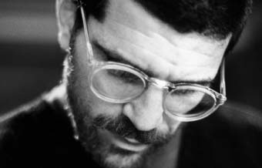
David Mamet
Atlantic Theater Company
Emphasis on poetic dialogues
off-Broadway plays :The Duck Variations, Sexual Perversity in Chicago,
and American Buffalo , Romance, Oleanna

Slide 7
Tony Kushner
Co-author of screenplay for Munich (2005) directed by Steven Spielberg
black comedy, tragedy, and spectacular dialogue, actors play multiple characters
Works: Angels in America: A Gay Fantasia on National Themes,
Hydrotaphia, Slavs!: Thinking About the Longstanding Problems of
Virtue and Happiness, A Bright Room Called Day, Homebody/Kabul

Slide 8
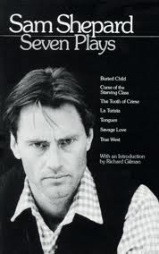
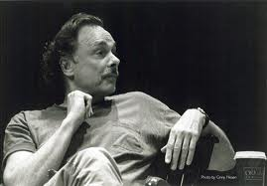
Sam Shepard
Collaboration with Bob Dylan
Works: Buried Child , Renaldo & Clara ,
Curse of the Starving Class
Arthur Lee Kopit
Works: Indians, (directed by Robert Altman) Oh Dad, Poor Dad, Mama's
Hung You in the Closet and I'm Feelin' So Sad: A Pseudoclassical Tragifarce
in a Bastard French Tradition

