Slide 1
Business Culture in Tourism. Culture Values
Krystyna Heinz

Slide 2
Outline of the lecture
Definition of culture values
Examples of culture values in various cultures
Taboo topics
Differences between European and Asian culture values
Summary

Slide 3
Definition
The most important thing for a group of people
Examples: family, money, religion, seniority, individualism, hierarchy
Czech culture - family, work, friends
Turkish culture – religion, family, work
Japanese culture – seniority, loyalty, politeness

Slide 4
Taboo topics – reflection of culture values
Japan- emperor, Yakuza, salary
Turkey- M.K. Atatűrk, sex, homosexuality
Czech Republic – salary, woman´s age, religion

Slide 5
Culture values – Europe and Asia
Huge differences - European x Asian countries
Individualism x collectivism
Politeness – it is not possible to disagree in a direct way
Japanese language – 16 ways of expressing negation in an indirect way
Indirect communication – information hidden in communication context

Slide 6
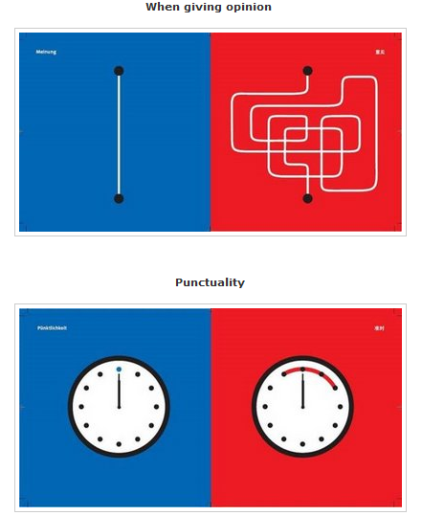
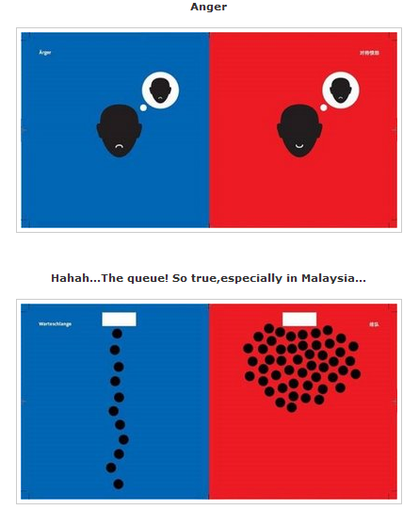
Explanation of basic differences

Slide 7
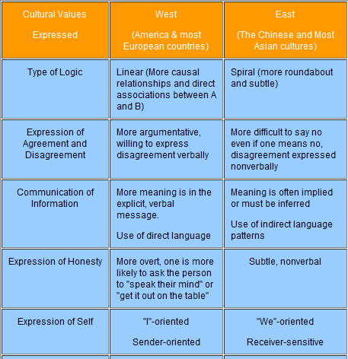
European and Asian culture values

Slide 8
Summary
Diversity of culture values
Differences between European and Asian culture values
Recommendations – tourism
Awareness about different culture background – different culture values
Empathy and tolerance

