Slide 1
Business Culture in Tourism. Acculturation. History and definition.
Krystyna Heinz

Slide 2
Outline of the lecture
Acculturation - history and definition
Honeymoon period
Acculturation today
Acculturation models
Acton-Walker model
Berry´s model
Summary

Slide 3
History
The term - first used in anthropology in the late 18th century
The consequences of contact between Native American tribes and whites
Later - important topic in the social sciences, sociology, psychology, and public health

Slide 4
Definition
Adaptation to target culture without losing national identity
The first definitions and models - the USA
Various nationalities
Late 20th century – 1970´ -development of business relations with Japan – comparison of cultures

Slide 5
Acculturation today
Acculturation – important for
Refugees
Immigrants
Students – Erasmus+
Other programs

Slide 6
Term - honeymoon period
the differences between the old and new culture are seen in a romantic light, wonderful and new
an individual might love the new foods, the pace of the life, the people's habits, the buildings
people are fascinated by the new culture
This period is full of observations and new discoveries

Slide 7
Acculturation models
Acton-Walker acculturation model
1 Tourist
2 Survivor
3 Immigrant
4 Citizen
Culture shock – between phases 1 and 2

Slide 8
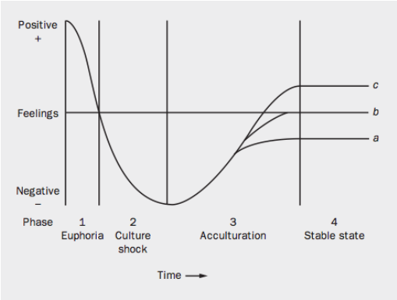
Acculturation models –Berry´s model

Slide 9
Summary
Acculturation - history and definition
Honeymoon period
Acculturation models
Options – fight, flight and adaptation

