Slide 1
Business Culture in Tourism. Culture shock. Its overcoming.
Krystyna Heinz

Slide 2
Outline of the lecture
Culture shock - definition
Symptoms – negative feelings
Sources of culture shock in the CR
Overcoming culture shock
Reverse culture shock
Summary

Slide 3
Definition
Culture shock or acculturative stress
Culture shock refers to the tension and feelings (of surprise, disorientation, uncertainty, confusion, etc.)
is felt when people have to operate within a different and unknown culture such as one may experience in a foreign country

Slide 4
Symptoms of culture shock
hostility
sadness
loneliness
homesickness
aggressiveness

Slide 5
Sources of culture shock in the CR-Erasmus+ students
Food – missing ingredients
Environment
Weather
Language
Unfriendly people, relations

Slide 6
Overcoming culture shock
Information about target culture
Contacts with people from home culture
Patience
Hobbies and interests
Activities enabling to practise the language

Slide 7
Reverse culture shock
may take place — after returning to one's home culture after getting accustomed to a new one
can produce the same effects
re-adjustment process to the primary culture
the affected person often finds this more surprising and difficult than the original culture shock

Slide 8
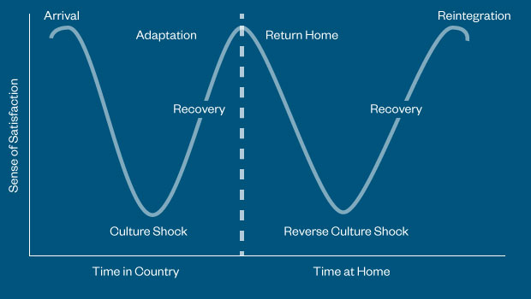
Acculturation models –Berry´s model

Slide 9
Summary
Culture shock - definition
Symptoms
Sources of culture shock in the CR
Reverse culture shock
Overcoming culture shock

