Slide 1
Business Culture in Tourism
Hotels and arrivals
Martina Chylková

Slide 2
Outline of the lecture
Types of accommodation
Hotel offer
Welcoming guests
Customer care
Registration of a new arrival

Slide 3
Types of accommodation
Hotel – cities, high-density tourist destinations, large amount of people
Bed & Breakfast – family or guests houses – 10 rooms
Motel – long distance journeys, minimum amenities and services
Hostels – limited budget travellers

Slide 4
Hotel offer
Unique travel packages
Leisure escapes
Bed & Breakfast
Instant getaway
Advance purchase
Weekend getaway package
Family fun package

Slide 5
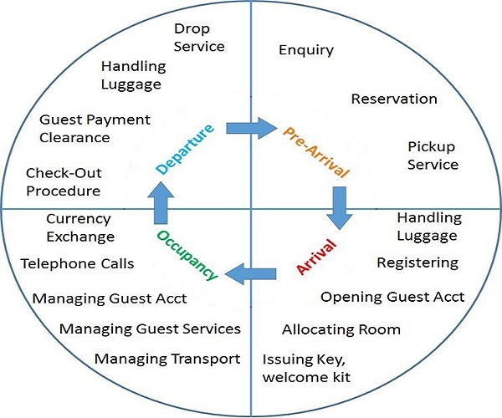
Hotel offer

Slide 6
Welcoming guests
8 rules for welcoming guests
smile when you greet the customer
listen to what the customer is saying
make eye contact, but do not stare
make sure you look interested
address the customer by name
do not interrupt the customer
keep reasonable distance from the customer, not too close and not too far
always thank the customer when appropriate

Slide 7
Customer care
Have you got the right attitude? Always or never?
1 Be loyal to the organization.
2 Respect the buildings and equipment where you work.
3 Criticize the organization to, or in front of, customers.
4 Be friendly and courteous with both colleagues and customers.
5 Argue or swear in front of customers.

Slide 8
Customer care
Have you got the right attitude? Always or never?
6 Lose your temper at work.
7 Drink alcohol at work.
8 Separate your private and professional life as far as possible.
9 Respect the view of others.
10 Act in a way that could put anyone at risk.
11 Be honest and constructive.
12 Ask if there is anything you are unsure about.

Slide 9
Registration of a new arrival
To allocate to give a guest a specific room
Identification e.g. a driving licence, a passport, an ID card, etc.
A guest history a computer file that shows details of a client’s previous stays in a hotel
A key card a plastic card with a magnetic strip for opening a door
Guest status the level of importance a guest has for a hotel
A registration card a card showing details of a guest’s stay in a hotel
A VIP an important guest
A walk-in a chance guest without reservation
A voucher a paper document to show that a guest has already paid

