Slide 1
Business Culture in Tourism
Hotel services
Martina Chylková

Slide 2
Outline of the lecture
Hotel positions
Skills in hospitality
Employability skills
Responsibilities

Slide 3
Hotel positions
Hospitality industry – wide range of positions
Serving as support staff
Dealing with customers
Front desk positions/ behind-the-scene - back office
Management level posts
Food service positions
Administrative jobs

Slide 4
Hotel positions
A lot of jobs to choose – degree, training, experience
Different types of accommodation – luxury hotels, motels, B&B
Similar types of positions – management
maintenance
kitchen and waiting staff
housekeeping
front desk staff
staff who purchase supplies
accounting work

Slide 5
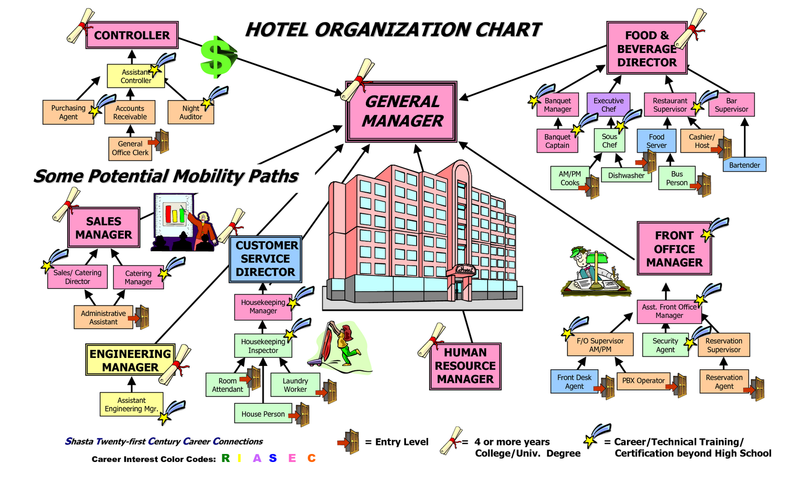
Hotel positions

Slide 6
Hotel positions
2 main types of positions:
Guest services
Administrative support
Front desk clerks – reception, to verify reservation, check room availability, check-in process, phone calls, making reservations (entry level job/ degree + experience)
Porters – full-service hotels, uniform, take care of luggage, room acceptable to a client, questions about hotel and services, all the hotel offers
Concierge- full-service/luxury hotels, liaisons with guests, specific service – babysitting – coordinate the service, dry cleaning, tickets, reservations, (entry-level job/ degree + experience)

Slide 7
Hotel positions
Housekeeping – repeat business, quality housekeeping staff
Room service – taking and delivering orders
Waiter/waitress – restaurant, breakfast, dinner, bill to a room/payments, guests’ needs
Kitchen staff – cooking, washing dishes, preparing salads, ordering supplies, planning menus, cooks/chefs
Accommodation
Food and beverage services
Recreation and entertainment
Transportation services

Slide 8
Employability skills
Communication skills
Team work
Problem solving
Good initiative and enterprising attitude
Planning and organizing skills
Good self-management
Lifelong learning attitude
Good technology know-how

Slide 9
Responsibilities
Meet and exceed quest’s expectations
Offer tourism information and promote local area
Use business skills
Sales and marketing skills
Administrative skills
Respond to enquiries and solve problems
Maintain facility, equipment and supplies

Slide 10
TOP 5 HOSPITALITY SKILLS
Customer service
Languages
Communication skills
Financial management
Cultural awareness

Slide 11
Hospitality skills
Skills needed for wait staff
communication
people skills
working quickly
multitasking
good memory

